Slide 1



Project Report on Survey Management System
Submitted BY: Tushar kumar Tamta Submitted TO:- MR MUKESH JANGID Id:- 1911985072

Slide 2
Purpose OF PROJECT
The main aim of developing this online survey system is to conduct an online survey on different topics to the users. In this Java Application, the user can take part in various online polls. In this system of survey, only the users authenticated by admin from the database system can drop their vote or express their viewpoint regarding the issue. Being online software, it can be logged on from anywhere with internet access. Admin in this application will add the polls regarding different questions and different topics and the admin can see the results of each poll in his dashboard.
Overall this project of ours is being developed to help the person taking the survey as well as person giving the survey in the best way possible and also reduce the human efforts.

Slide 3
Roles
USER
ADMIN
User Dashboard
Available Surveys.
Responding to Surveys.
Creating new Surveys.
Admin Dashboard
Displays all Surveys.
Editing Surveys.
Creating new Surveys.
Displaying Results.

Slide 4
Technologies used
FRONT-END
:- HTML,CSS,TypeScript,Angular JS,Matcard,
MatSnackBar,canActiveGuard.etc
BACK-END
:- Spring-Boot,JWT,SMTP,Hibernate.etc
DATABASE
:- MySQL

Slide 5
FRONTEND:- Angular js
Angular is an application design framework and development platform for creating efficient and sophisticated single-page apps.
Angular is a development platform, built on TypeScript As a platform, Angular includes:
A component-based framework for building scalable web applications
A collection of well-integrated libraries that cover a wide variety of features, including routing, forms management, client-server communication, and more
A suite of developer tools to help you develop, build, test, and update your code

Slide 6
Back-end:- Springboot
Spring Boot helps you to create stand-alone, production-grade Spring-based applications that you can run
Spring Boot is used to create Java applications that can be started by using java -jar or more traditional war deployments. We also provide a command line tool that runs “spring scripts”.
Our primary goals are:
• Provide a radically faster and widely accessible getting-started experience for all Spring development.
• Be opinionated out of the box but get out of the way quickly as requirements start to diverge from the defaults. • Provide a range of non-functional features that are common to large classes of projects (such as embedded servers, security, metrics, health checks, and externalized configuration).
• Absolutely no code generation and no requirement for XML configuration.

Slide 7
Database:-My-SQL
MySQL, the most popular Open Source SQL database management system, is developed, distributed, and supported by Oracle Corporation.
Some Of the features are:
Works on many different platforms.
Written in C and C++.
Uses multi-layered server design with independent modules.
Designed to be fully multithreaded using kernel threads, to easily use multiple CPUs if they are available.
Provides transactional and non-transactional storage engines.
Uses a very fast thread-based memory allocation system.

Slide 8
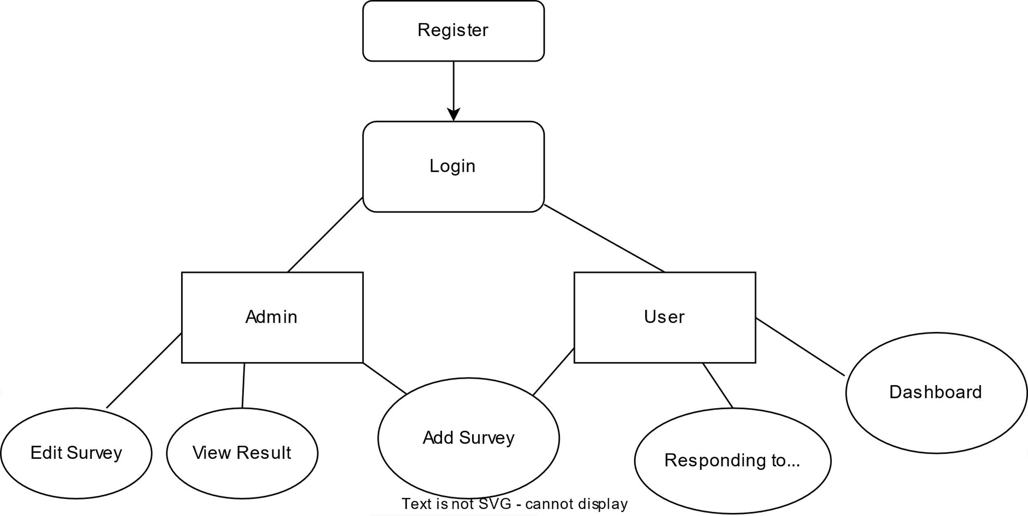
Data Flow Diagram:-

Slide 9
Features of the project-

Slide 10
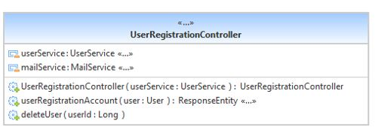
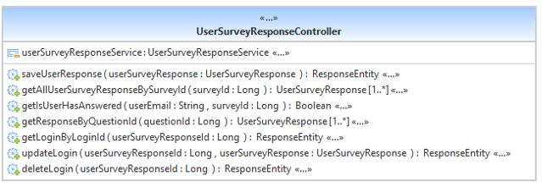
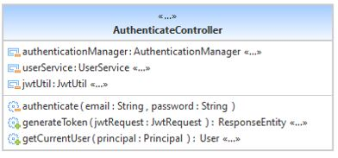
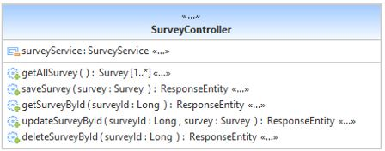
UML diagram :-

Slide 11
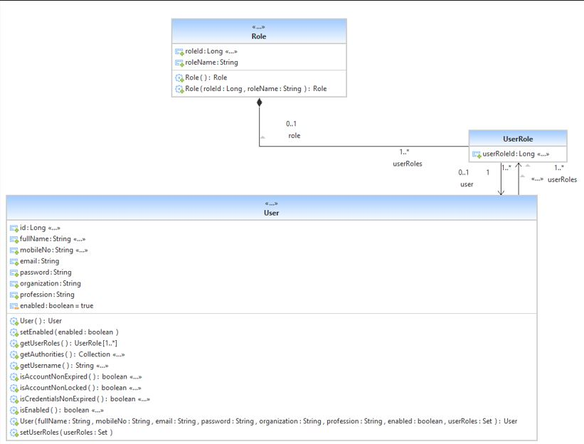
UML diagram (models):-

Slide 12
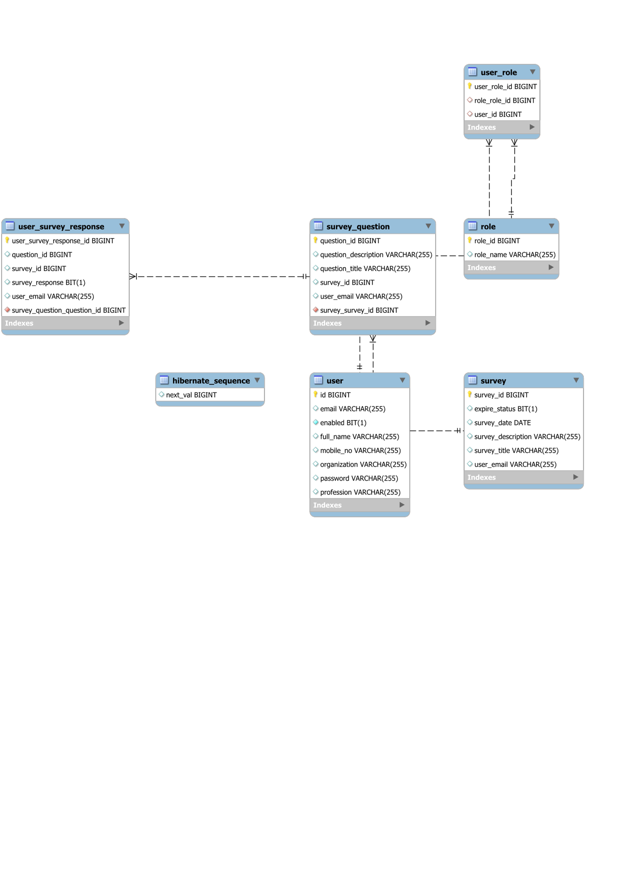
ER diagram

Slide 13
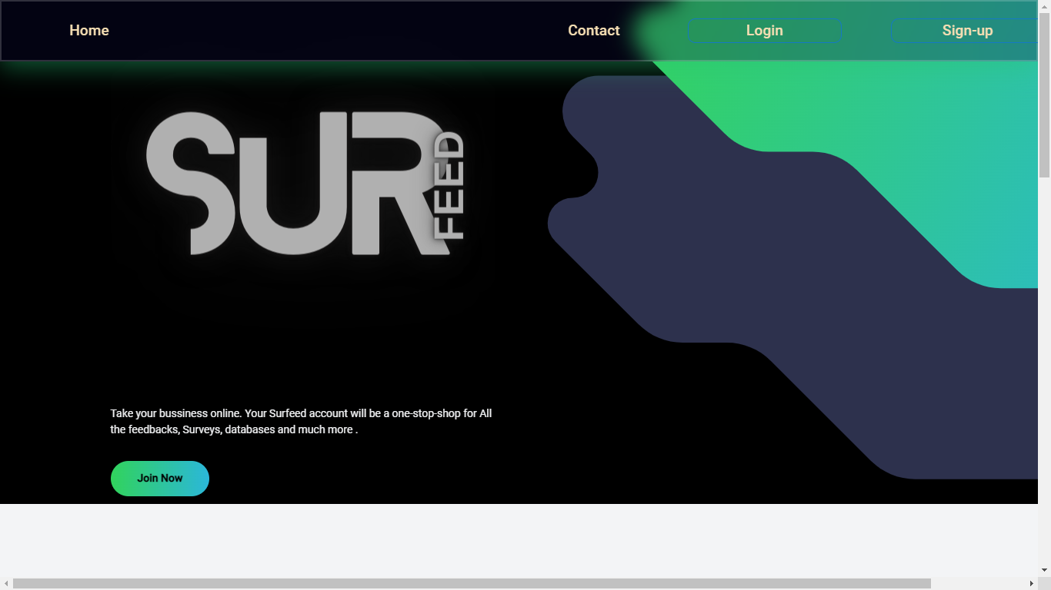
Screenshots
SurFeed Home Page 1

Slide 14
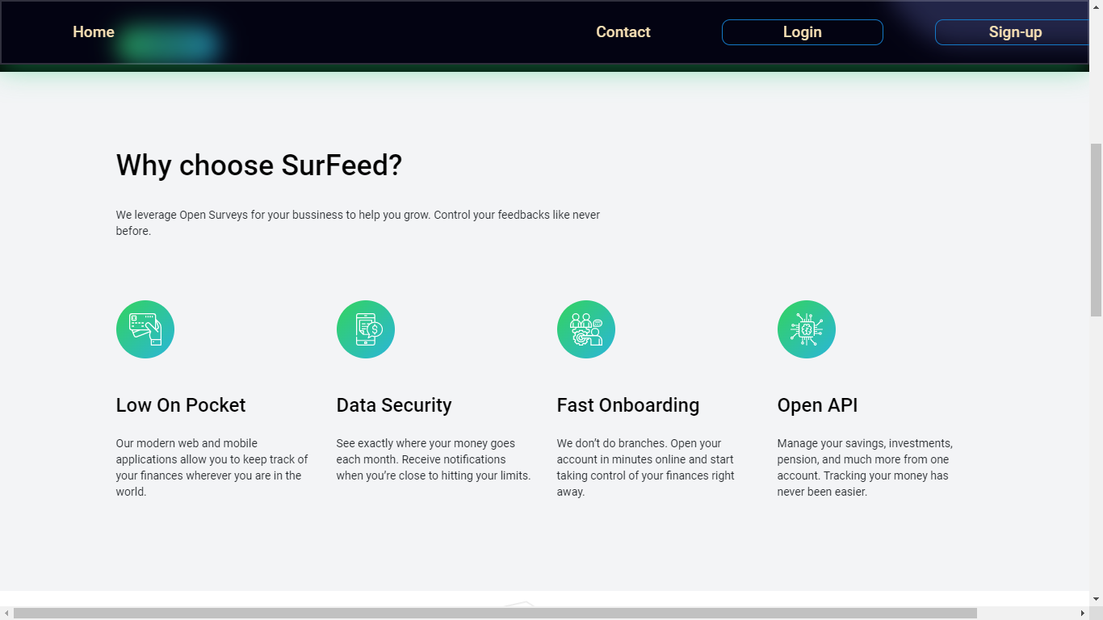
SurFeed Home Page 2

Slide 15
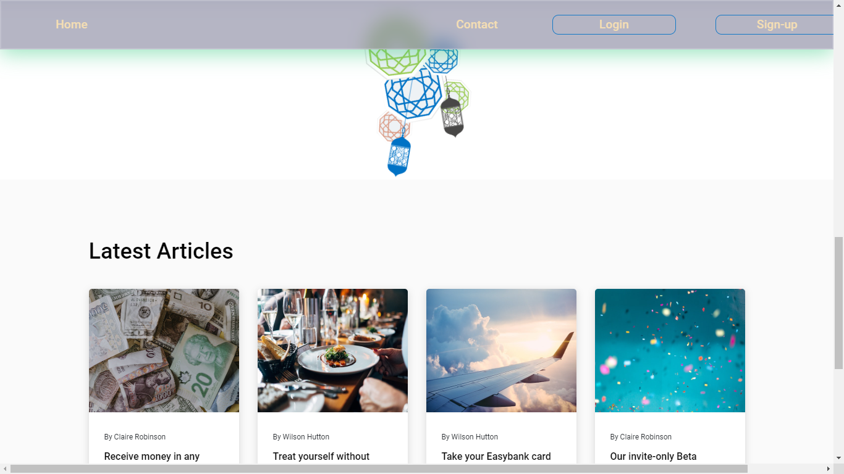
SurFeed Home Page 3

Slide 16
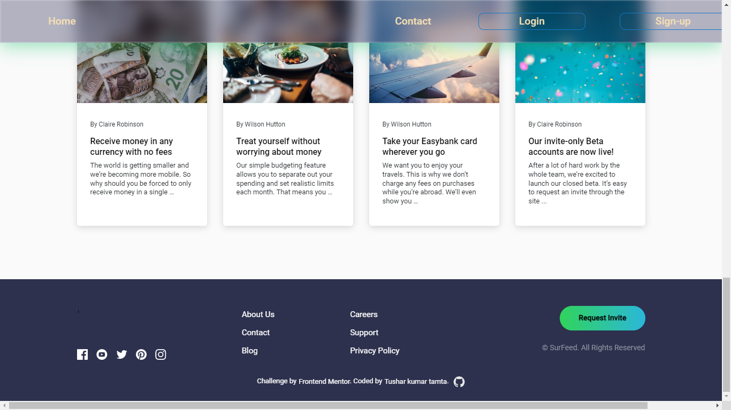
SurFeed Home Page 4

Slide 17
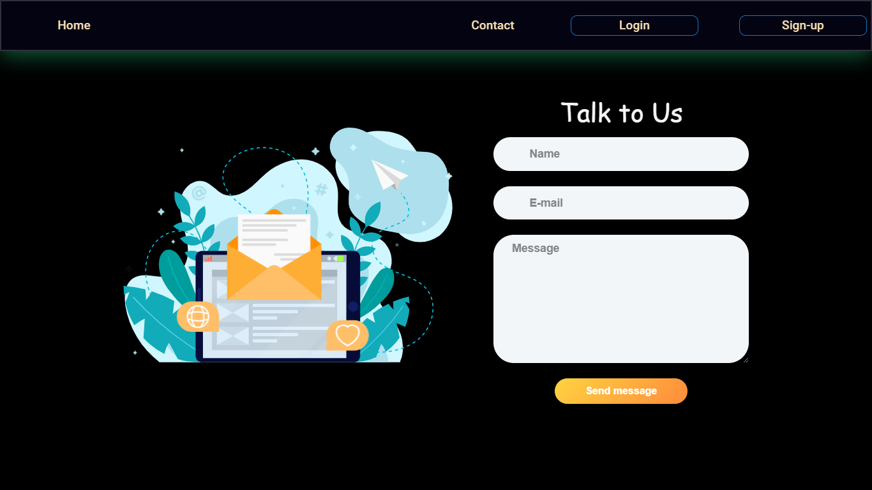
SurFeed Contact Us 4

Slide 18
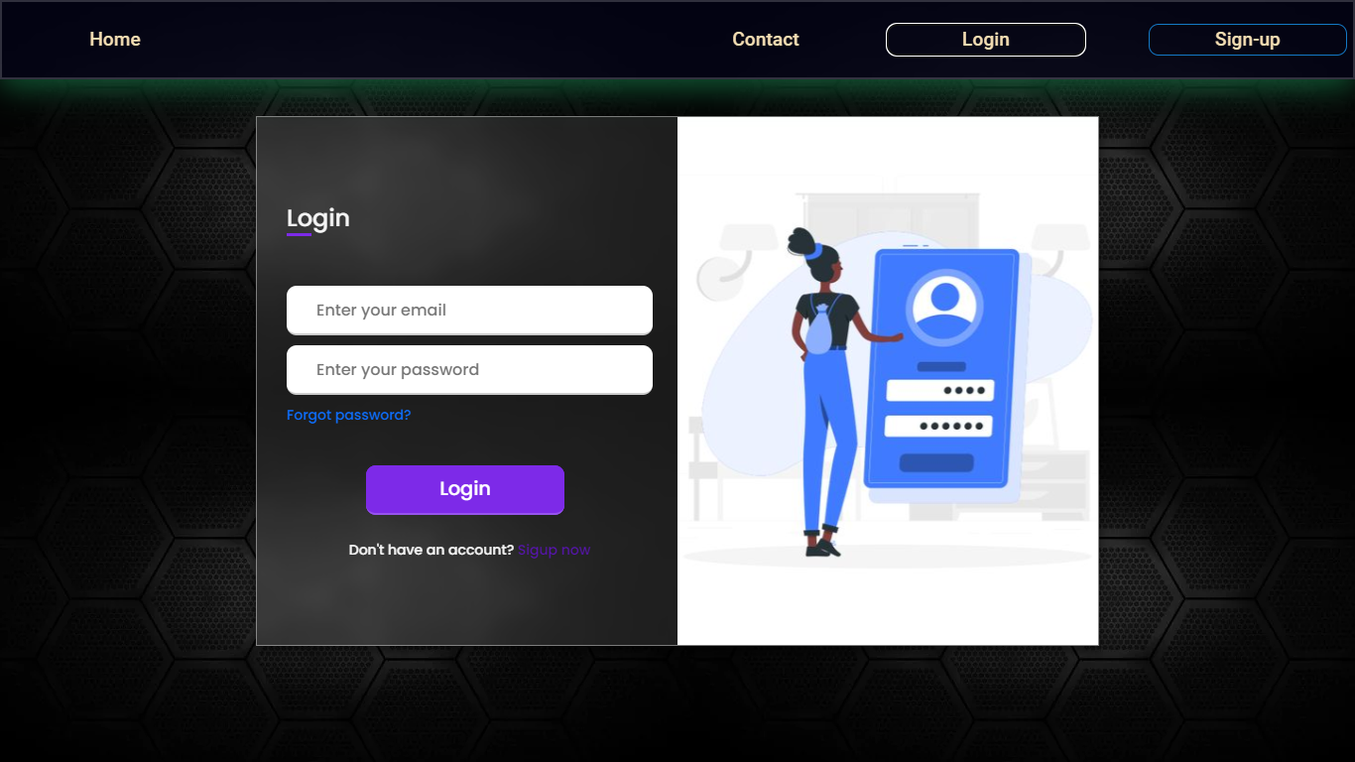
Login Page

Slide 19
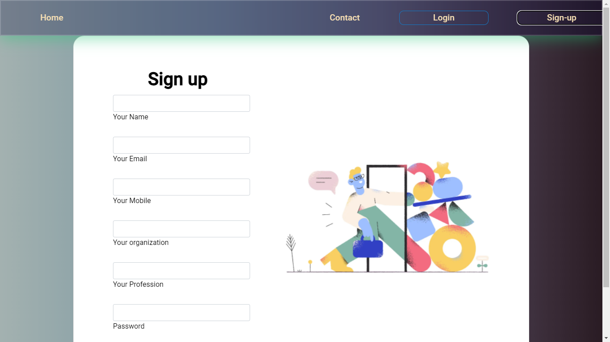
Signup Page

Slide 20
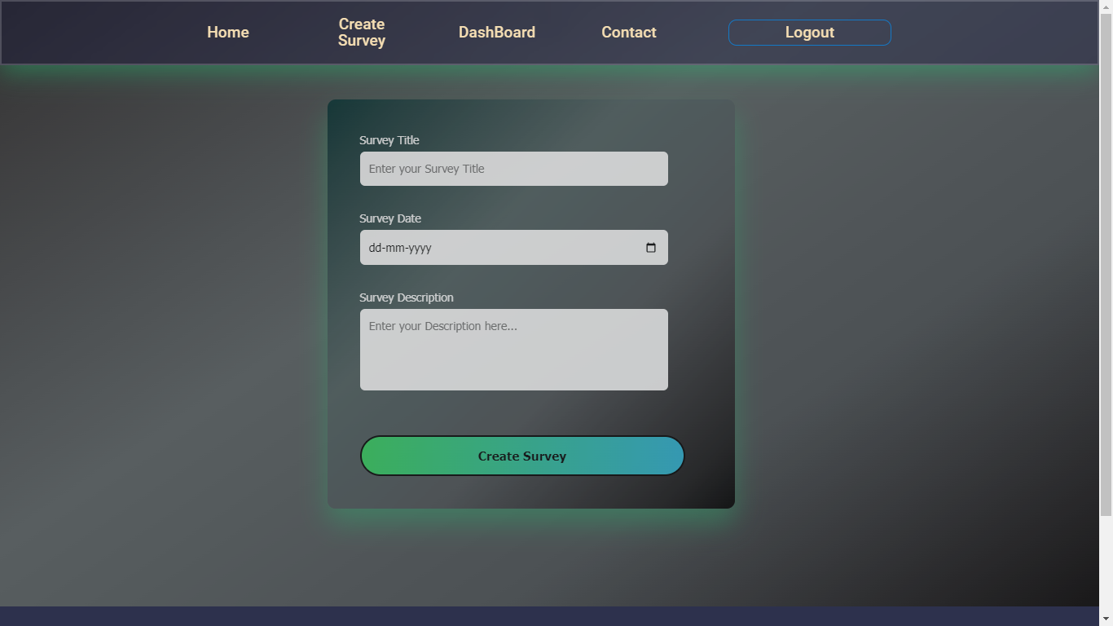
Create Survey Page

Slide 21
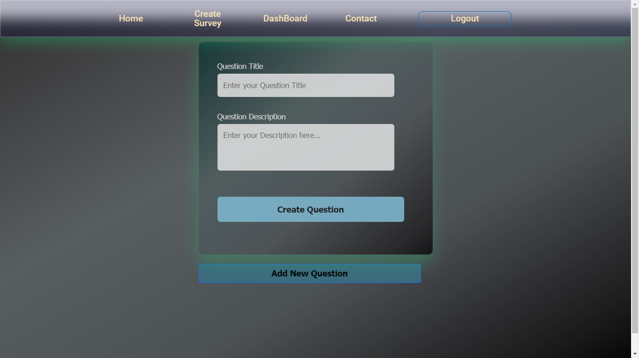
Add Question Page

Slide 22
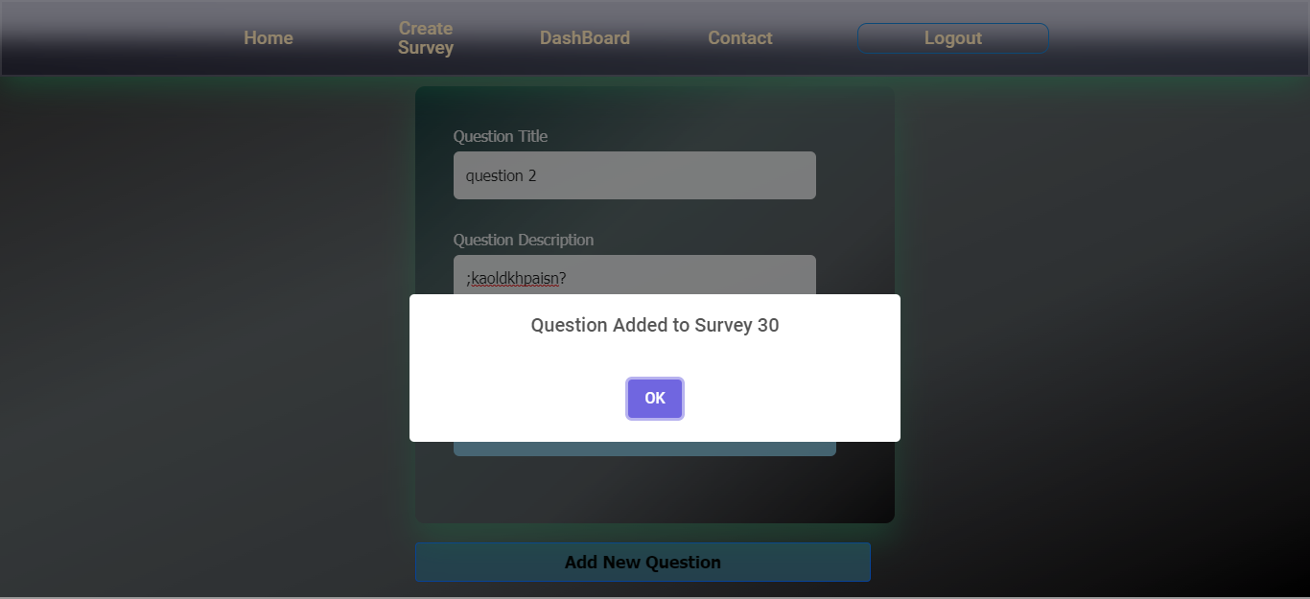
Adding a QUESTION

Slide 23
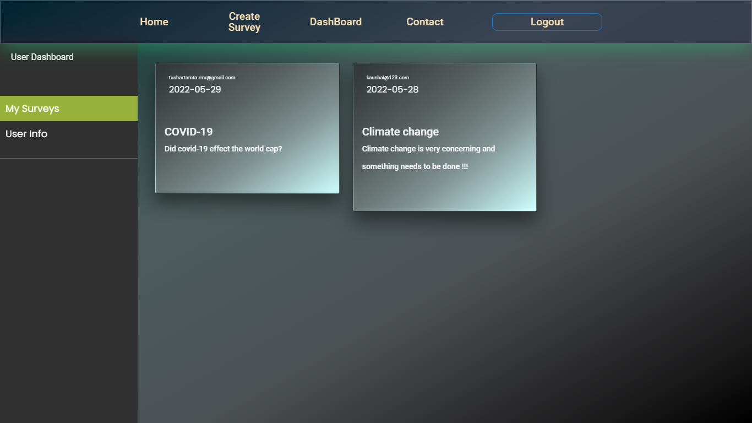
Dashboard-Surveys taken

Slide 24
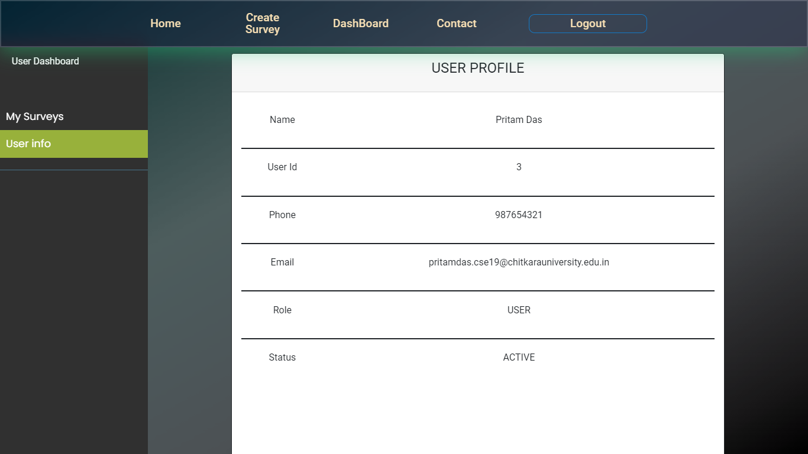
Dashboard-UserInfo

Slide 25
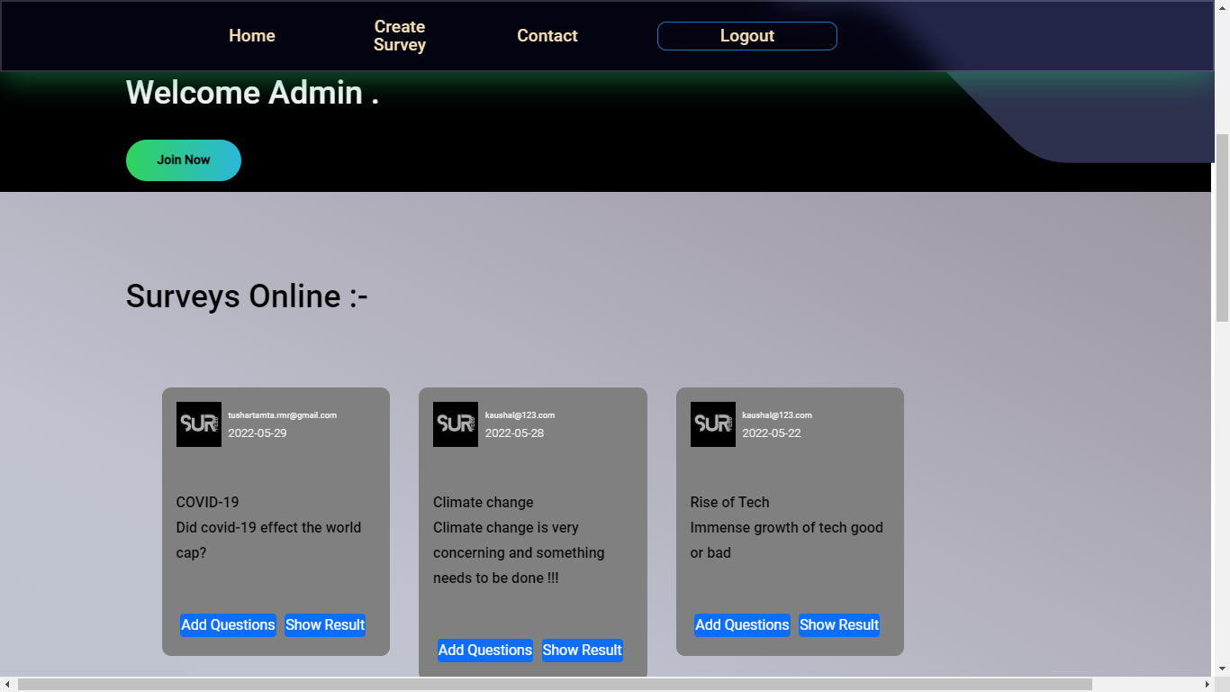
Admin-Survey Control Panel

Slide 26
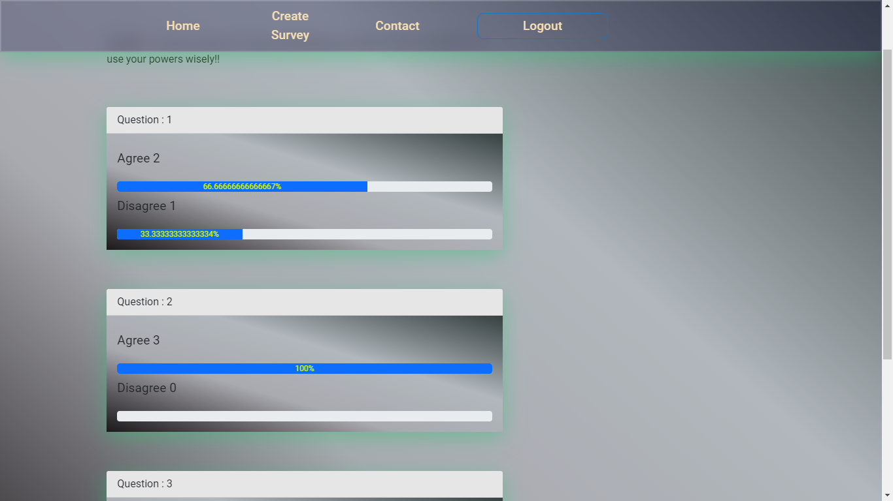
Admin-Result of survey

Slide 27
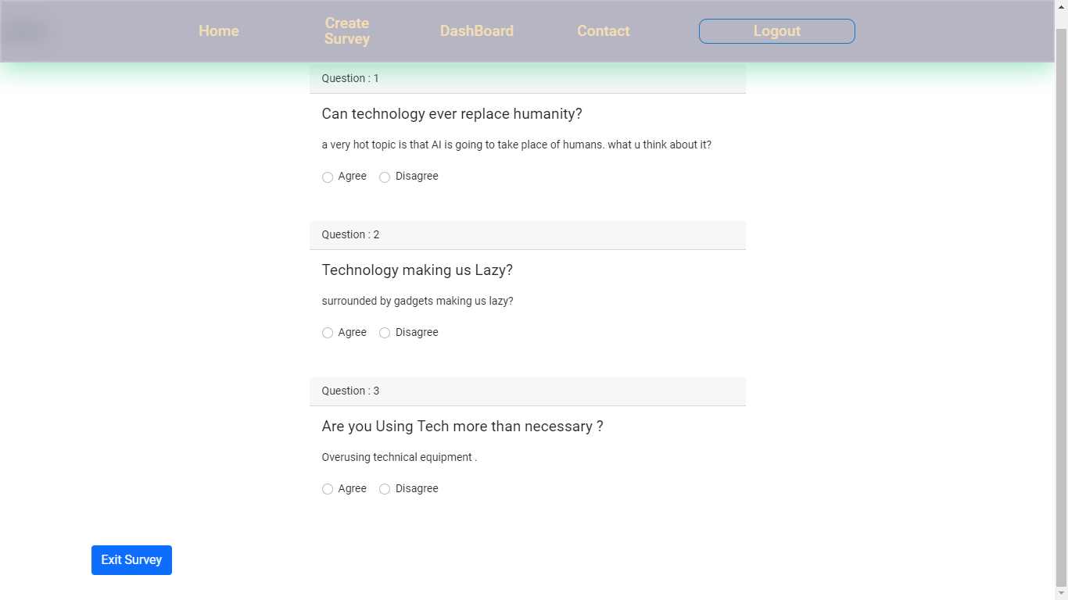
Survey Questions

Slide 28
FUTURE SCOPE
In the Coming times where freedom of speech and freedom of expression is going to be promoted greatly on Various social sites and platforms, then our survey Site is going to play a vital role in promoting the same with more advanced and advantageous features.
Also opinion of a common man is also considered important as these small opinions takes the face of big decisions and makes a big impact on what is going to happen next and how things will shape in the coming times. As we know one can approach only near perfection and there is always a scope of improvement with the change in time.
Hence our project too have some future scope of improvements which will going to make our website more easy to use and future proof.

Slide 29
Scope Of improvements in near future
Ability to login directly with Google SignUp.
Verification and Identification Of User with Govt. approved ID to avoid fake inputs.
More Admin-User Transparency While Attempting and Showing Results of Survey
Right to admin to block users trying to make fake inputs to the survey.

Slide 30


THANK YOU

